Slide 1
Secure Data Hiding in Images Using Steganography
CAPSTONE PROJECT
Presented By:
Student Name : ANUBHAV LAL
College Name & Department : SRM Institute of Science and Technology (MCA)

Slide 2
OUTLINE
Problem Statement
Technology used
Wow factor
End users
Result
Conclusion
Git-hub Link
Future scope

Slide 3
Problem Statement
Traditional data transmission methods are vulnerable to interception and cyber threats.
Existing encryption techniques may attract attention, making data transmission suspicious.
There is a need for a secure method to hide messages within images to prevent detection.
This project addresses secure message encoding and decoding in images using cryptography.

Slide 4
Technology used
Programming Language: Python
Libraries Used:
OpenCV (Image Processing)
Cryptography (Fernet) (Encryption & Decryption)
PyQt5 (Graphical User Interface)
Base64 & Hashlib (Key Generation & Encoding)
Platforms: Windows, Linux

Slide 5
Wow factors
Double Layer Security: Encrypts messages before embedding them in images.
User-Friendly GUI: Built using PyQt5 for easy interaction.
Minimal Data Distortion: Preserves image quality while hiding data.
Password-Protected Steganography: Only users with the correct password can retrieve hidden messages.
Lightweight & Efficient: Works on standard images without excessive computational power.

Slide 6
End users
Cybersecurity Professionals: Securely transmit sensitive information.
Journalists & Activists: Communicate securely in restricted environments.
General Users: Hide private messages within images for personal use.
Government & Intelligence Agencies: Conceal classified information in multimedia.

Slide 7
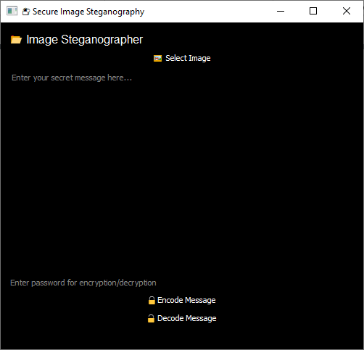
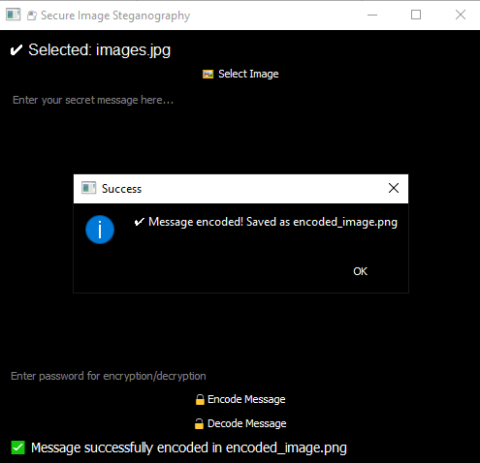
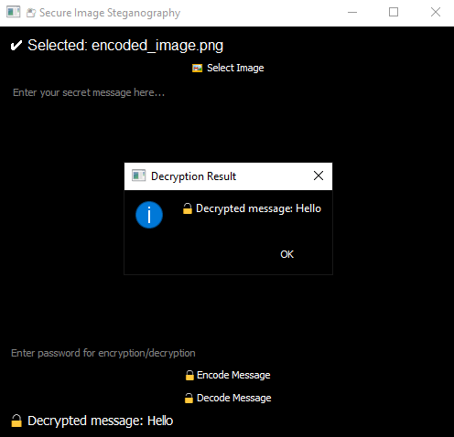
Results

Slide 8
Conclusion
This project provides a secure and covert method to transmit sensitive information.
It combines steganography and encryption, ensuring enhanced data security.
The system offers an intuitive interface for encoding and decoding messages in images.
Helps prevent unauthorized access by making data undetectable within images.

Slide 9
GitHub Link
https://github.com/anubhavlal07/imageStegnography.git

Slide 10
Future scope(optional)
Integration with Video Files: Extending the technique to conceal messages within videos.
AI-Based Detection Resistance: Making hidden messages undetectable by machine learning models.
Cloud Integration: Secure steganographic messaging over cloud platforms.
Support for Multiple File Types: Expanding beyond images to audio and document steganography.

Slide 11
THANK YOU

